Slide 1
The SEL 3 Signature Practices

Slide 2
Welcoming and Inclusion Activities
Start your meetings/lessons with a Welcoming/Inclusion Activity to cultivate connection, community and belonging.
Slides 3-19 are examples. Directions for activities are in the slide notes.
Skip to slide 24 for Engaging Strategies and Brain Breaks.

Slide 3
Welcoming/Inclusion Activity
I wish _____ would _____.
I wish _____ wouldn’t _____.
Notes:
Purpose:
Promote a supportive climate
Encourage a growth mindset
Create conditions to encourage participants to engage in authentic conversations about needs, values, goals, and current issues so they feel seen, heard, and valued.
Improve the climate of belonging, self-worth, and justice amongst students, families, staff when you give an opportunity to ACKNOWLEDGE the issues and then take a next step to work on their concerns. (Response to Recovery 5.1)
Offer a simple way to transition a group into a learning space while honoring a diversity of experiences and voices.
Promote connectedness within a group.
*It is a good example of a “low vulnerability” activity. Each person decides for themselves what level of personal experience they wish to share.
*To raise the vulnerability (for admin and/or teachers), you can write on sticky notes and place them on 10 different posters. Conduct a Gallery Walk and every person place a check mark next to the ones that resonate with them. This is a great way to measure values, concerns, issues, etc.
There are 10 sentence stems in all. 5 slides included. Depending upon your time frame, use 1 set per meeting or choose them all. They may ALSO be used as great reflective closers. Perhaps the stems would have changed during the meeting, etc. You have a lot of flexibility to adapt them.

Slide 4
I need… I don’t need…
Notes:
Purpose:
Promote a supportive climate
Encourage a growth mindset
Create conditions to encourage participants to engage in authentic conversations about needs, values, goals, and current issues so they feel seen, heard, and valued.
Improve the climate of belonging, self-worth, and justice amongst students, families, staff when you give an opportunity to ACKNOWLEDGE the issues and then take a next step to work on their concerns. (Response to Recovery 5.1)
Offer a simple way to transition a group into a learning space while honoring a diversity of experiences and voices.
Promote connectedness within a group.
*It is a good example of a “low vulnerability” activity. Each person decides for themselves what level of personal experience they wish to share.
*To raise the vulnerability (for admin and/or teachers), you can write on sticky notes and place them on 10 different posters. Conduct a Gallery Walk and every person place a check mark next to the ones that resonate with them. This is a great way to measure values, concerns, issues, etc.
There are 10 sentence stems in all. 5 slides included. Depending upon your time frame, use 1 set per meeting or choose them all. They may ALSO be used as great reflective closers. Perhaps the stems would have changed during the meeting, etc. You have a lot of flexibility to adapt them.

Slide 5
I want… I don’t want…
Notes:
Purpose:
Promote a supportive climate
Encourage a growth mindset
Create conditions to encourage participants to engage in authentic conversations about needs, values, goals, and current issues so they feel seen, heard, and valued.
Improve the climate of belonging, self-worth, and justice amongst students, families, staff when you give an opportunity to ACKNOWLEDGE the issues and then take a next step to work on their concerns. (Response to Recovery 5.1)
Offer a simple way to transition a group into a learning space while honoring a diversity of experiences and voices.
Promote connectedness within a group.
*It is a good example of a “low vulnerability” activity. Each person decides for themselves what level of personal experience they wish to share.
*To raise the vulnerability (for admin and/or teachers), you can write on sticky notes and place them on 10 different posters. Conduct a Gallery Walk and every person place a check mark next to the ones that resonate with them. This is a great way to measure values, concerns, issues, etc.
There are 10 sentence stems in all. 5 slides included. Depending upon your time frame, use 1 set per meeting or choose them all. They may ALSO be used as great reflective closers. Perhaps the stems would have changed during the meeting, etc. You have a lot of flexibility to adapt them.

Slide 6
I can… I can’t…
Notes:
Purpose:
Promote a supportive climate
Encourage a growth mindset
Create conditions to encourage participants to engage in authentic conversations about needs, values, goals, and current issues so they feel seen, heard, and valued.
Improve the climate of belonging, self-worth, and justice amongst students, families, staff when you give an opportunity to ACKNOWLEDGE the issues and then take a next step to work on their concerns. (Response to Recovery 5.1)
Offer a simple way to transition a group into a learning space while honoring a diversity of experiences and voices.
Promote connectedness within a group.
*It is a good example of a “low vulnerability” activity. Each person decides for themselves what level of personal experience they wish to share.
*To raise the vulnerability (for admin and/or teachers), you can write on sticky notes and place them on 10 different posters. Conduct a Gallery Walk and every person place a check mark next to the ones that resonate with them. This is a great way to measure values, concerns, issues, etc.
There are 10 sentence stems in all. 5 slides included. Depending upon your time frame, use 1 set per meeting or choose them all. They may ALSO be used as great reflective closers. Perhaps the stems would have changed during the meeting, etc. You have a lot of flexibility to adapt them.

Slide 7
I am… I am not…
Notes:
Purpose:
Promote a supportive climate
Encourage a growth mindset
Create conditions to encourage participants to engage in authentic conversations about needs, values, goals, and current issues so they feel seen, heard, and valued.
Improve the climate of belonging, self-worth, and justice amongst students, families, staff when you give an opportunity to ACKNOWLEDGE the issues and then take a next step to work on their concerns. (Response to Recovery 5.1)
Offer a simple way to transition a group into a learning space while honoring a diversity of experiences and voices.
Promote connectedness within a group.
*It is a good example of a “low vulnerability” activity. Each person decides for themselves what level of personal experience they wish to share.
*To raise the vulnerability (for admin and/or teachers), you can write on sticky notes and place them on 10 different posters. Conduct a Gallery Walk and every person place a check mark next to the ones that resonate with them. This is a great way to measure values, concerns, issues, etc.
There are 10 sentence stems in all. 5 slides included. Depending upon your time frame, use 1 set per meeting or choose them all. They may ALSO be used as great reflective closers. Perhaps the stems would have changed during the meeting, etc. You have a lot of flexibility to adapt them.

Slide 8
Welcoming and Inclusion Activity
Notes:
Slide 1 of 2
Purpose:
Promote a supportive climate
Create conditions to encourage participants to engage in authentic conversations about needs, values, goals, and current issue so they feel seen, heard, and valued.
Improve the climate of belonging, self-worth, and justice amongst students, families, staff when you give an opportunity to ACKNOWLEDGE the issues and then take a next step to work on their concerns. (Response to Recovery 5.1)
Offer a simple way to transition a group into a learning space while honoring a diversity of experiences and voices.
Promote connectedness within a group.
Let's Consider the Relationship between Names and Identity
If each individual in the United States contributes to the nation’s collective identity, then it makes sense to start a course exploring United States history, for example, by thinking about the individuals who comprise the nation.
According to American author Ralph Ellison, “It is through our names that we first place ourselves in the world. Our names, being the gift of others, must be made our own.”
Indeed, when we meet someone new, our name is usually the first piece of information about ourselves that we share. It is often one of the first markers of our identity that others learn.

Slide 9
Explore the Broader Identity a Name Represents:
•Write your full name.
•How did you get your name?
•If you know, tell what your name means.
•Describe a special significance it has for you.
•What other names or nicknames do people call you?
Notes:
Slide 2/2
As we explore the broader identity our name represents I'd like you to reflect on how well you think your own name reflects who you are. On a piece of paper, I'd like you to write your FULL name. How did you get your name? If you know, tell what your name means. Describe a special significance it has to you. What other nicknames do people call you? What comes to mind when you think about your name? How does your name reflect the cultural and historical context in which you were born? (Give 2 minutes to reflect)
Play some Alex de Grassi music in the background. :-)
When time is up, facilitator share the story about your name to model...
▶Your full name
▶What is significant about your name? What does it mean? How did you get your name?
▶By what other names are you known?
▶We're going to head into groups of _____. We will paste additional sentence stems for you to explore together. Share/discuss stories about your name--you get to choose what you want to share with your group. Thank you for practicing equity of voice and we'll see you back in 8 minutes.
As an extension, explore the broader identity your name represents by discussing how well you think your own name reflects who you are:
•I was given my name because . . .
•I like/dislike my name because . . .
•My name is/isn’t a good fit for my personality because . . .
•Describe a time when someone made an assumption about you because of your name.
•Describe a time when your name affected your behavior.
•Bonus Question: How does your name reflect the cultural/historical context into which you were born?
Keep discussing until I give you a cue.
▶Debrief: What are the benefits of talking about names? How can this promote a supportive climate? What did you notice about the participants stories?

Slide 10
Welcome/Inclusion Activity and Reflective Close:
Find the Bright Spots
Notes:
Elena Aguilar references this activity in Onward: Cultivating Emotional Resilience in Educators pgs 174-5
Purpose:
1. Focus on strengths, assets and bright spots.
2. Create a positive culture and climate, build relationships.
As an aside, one of the positive side-effects: It improves behavior. Focusing on “bright spots” has been extensively researched in psychology, organizational change management and neuroscience. Those fields all agree that focusing on the positive not only feels good but also works when you’re trying to change or you want others to change (175).
1.Have participants legibly write their names on paper and drop it in a basket on their way to their seats.
2.Remind the group the importance of knowing everyone’s name and how that helps create a sense of belonging and connectedness in our learning community. Prep them for a quick review in a brief community building circle. Each person states their name and ___________________. (Think of another LOW-RISK item for them to share…what weather pattern represents how they feel right now…their favorite meal, etc.
3. “Now that we’ve reviewed names, each of you will pull a name out of the basket. Here are the rules: 1. Keep it TOTALLY secret – don’t tell anyone who you drew! 2. Observe this person all class period and find behaviors to appreciate. (all day if you are in ES). You may need to review what positive behaviors look like with your group.
4. At the end of the period, day, week, etc., get into a community circle. Reveal who you’ve been watching and share your appreciations about their behaviors.
5. Debrief: What did you observe after participants offered and received appreciations? How did this make you feel? What are the benefits of sharing the bright spots?
Perhaps you can make a point to do this once a week. Imagine if adults did this in PLCs or for non-evaluative walkthroughs.

Slide 11
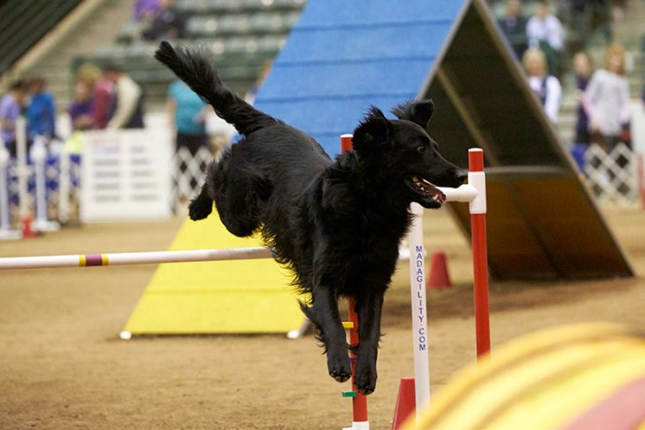
Welcoming/Inclusion Activity
"Emotional agility allows us to be our authentic selves for everyone, every day."
Notes:
Purpose:
Promote a supportive climate
Encourage a growth mindset
Create conditions to encourage participants to engage in authentic conversations about needs, values, goals, and current issues so they feel seen, heard, and valued.
Improve the climate of belonging and self-worth when you give an opportunity to ACKNOWLEDGE where we are emotionally (self-awareness) and then take a next step to work on concerns. (Response to Recovery 5.1)
Offer a simple way to transition a group into a learning space while honoring a diversity of experiences and voices.
Promote connectedness within a group.
"Emotional agility allows us to be our authentic selves for everyone, every day." ~Susan David
"Emotional agility is the absence of pretense and performance, which gives your actions greater power because they emanate from your core values and core strength, something solid and genuine and real.
We reach that level of REAL, that level of emotional agility, not through magic, but through a series of tiny steps in everyday moments over the course of a lifetime." Susan David, author of Emotional Agility
You may need to operationally define before you send them off to discuss: "Agility is the ability to move quickly and easily, to think clearly and understand speedily, and to be sharp. Those with mental and or physical acuity make what they are doing look effortless and do so with excitement."
Ask participants to discuss with a partner; you and partner then find another pair to discuss, and then discuss the implications with the whole group.
What tiny steps can you take this week to strengthen your agility and stay the course? How will they help you personally? How will your students benefit? How will your colleagues benefit?
If you’re looking for resources to further explore emotional agility, watch Susan David's TED Talk, try her free quiz, or read the book.

Slide 12
Welcoming/Inclusion Activity
One thing I like about myself...
One thing I'm proud of...
One thing I'm good at...
One thing that makes me me is...
Notes:
Purpose: Put people in the right mindset in order to create the conditions that encourage positive self-talk and reflection. Participants can engage in authentic conversations about who they are and celebrate themselves; this can improve the climate of belonging, self-worth, and justice amongst students, families, staff…(Response to Recovery 5.1)
Adapted from Project Wayfinder
A. One thing I like about myself...
B. One thing I'm proud of...
C. One thing I'm good at...
D. One thing that makes me me is...
Write a "toast" to yourself and share it with a partner and/or your table mates:
"I want to give a toast to someone who...(Write your response to Prompt A), (write your response to Prompt B), (write your response to Prompt C), (write your response to Prompt D). And that person is me.“
You can modify the language to, “I want to give a shout out…” or “I want to give a high five to…”
Model an example: "I want to give a toast to someone who truly cares about people, is a proud mom of 2 sons, who prioritizes connection and who loves to sing and dance even when no one is looking...and that person is me.“
Share your dedication with a shoulder partner or small group. Whole group share? (That takes courage, so be sure to thank the volunteers.)
Debrief: How did it feel to share your toast? Where does negative self-talk come from? What are some social + cultural factors that influence our self-talk? How might you practice positive self-talk more often? How can this contribute to having a sense of belonging? How can an activity like this cultivate belonging in your classroom?
Place your dedication in a spot where you will see it.
Elena Aguilar, author Onward: Cultivating Emotional Resilience in Educators, reminds readers that, “Saying affirmations to yourself raises your levels of feel-good hormones and pushes your brain to form new clusters of “positive thought” neurons” (82).
Option for a Closer ~ Purpose: Cultivate a culture of personal connection, mutual support and belonging. Create a scenario for participants to write a dedication for someone else and give it to them. Perhaps for a student, a spouse, someone from the department, grade-level, a parent, or maybe the person sitting to their left at the meeting, so EVERYONE receives an affirmation.

Slide 13
Welcoming/Inclusion Activity
Notes:
Purpose:
Encourage a growth mindset
Create conditions to encourage positive self-talk, collective efficacy and reflection.
Offer a simple way to transition a group into a learning space while honoring a diversity of experiences and voices.
Promote connectedness and a sense of belonging within a group.
It is a good example of a “low vulnerability” activity. Each person decides for themselves what level of personal experience they wish to share.
*SEL Indicators: Build Self-awareness by encouraging participants to reflect while simultaneously addressing Relationship Skills as participants speak and listen to each other, respectfully share, and receive information.
Think of something positive that happened to you today in your classroom, with a student, with an administrator, a parent...at home with a family member—anything! Perhaps you have something good coming up in the near future that you can share.
2. Celebrate/share in pairs, triads, whole group—it depends on how much time you decide to give it. Rotate a few times. Students and adults love it when you play the song. I often put them in pairs and then have them rotate so they share their good news with at least 3 people. Implement it every 2 weeks—some do it every Monday to start the week. Heads-up: If you use Chaka Khan's song in the classroom, cut to 1:11 b/c of the words. Students and adults alike love it when you play the song.
3. If in a secondary school, choose ONE class period and implement it school-wide so students don’t have to do it 7 times!
This is a variation of What’s New on page 13 of 3 Signature Practice Playbook

Slide 14
Welcoming/Inclusion Activity
Think of someone for whom you would like to make the world safe and be able to explain why. What does safety look like?
Notes:
Purpose: This opener encourages dialogue about building strong relationships. It supports connectedness, learning about each other's identities, creating a climate where we feel comfortable to communicate with each other together, and promotes a sense of belonging. You could even use this to open a community meeting where you want to address the challenge of reducing youth violence. In order to model being the SEL skill of being fully present, use the following Debriefing Strategy:
1. Find a partner
2. Partner A share your thoughts for 30 seconds. Partner B must listen WITHOUT commenting. You may use appropriate non-verbal expression.
3. Partner B share your thoughts for 30 seconds. Partner A must listen without commenting. You may use appropriate non-verbal expression.
4. Debrief with entire group: How did this feel to be Partner A? Partner B?
5. Partners, now take 1 minute for a general discussion about making the world safe.
6. Whole group share-out. Thoughts? What resonates with you?
*This is a LOW vulnerability prompt.
Go to the NEXT Prompt to raise the level of vulnerability and use the same debriefing activity. Discuss what safety looks like at our school and/or classroom. What does it look like and what are ways it needs to improve?
After the whole group share-out, ask your staff to generate and agree upon 3 strategies that you will ALL be more intentional about in the next week, month, etc.

Slide 15
Welcoming/Inclusion Activity
Describe the actions of a teacher who helped build a strong relationship with you.
Notes:
Purpose: This opener encourages dialogue about building strong relationships. It supports connectedness, learning about each other's identities, creating a climate where we feel comfortable to communicate with each other together, and promotes a sense of belonging.
Partner up and discuss for 5 minutes—you each will get 2.5 minutes, so be intentional about your equity of voice. :-)
Describe the actions of a teacher who helped build a strong relationship with you. This could have been when you were in school, college, or even right now on your staff. What made the biggest impact on you? Why?
Whole group debrief:
1. What emotions did that evoke when you were talking about those teachers who build a strong relationship with you?
2. Let's create a list of characteristics to describe those people. Put up on poster paper and then read out loud.
3. Next Steps: Think of 3-5 people on your roster who may need a bit of "extra grace and/or love" this week. Write down at least one thing you will do this week to improve your relationship with them. We'll report back next week. :-)

Slide 16
Welcoming/Inclusion Activity
One thought, issue, or topic I'm leaving at the door today: ______________________.
One thought, issue, or topic I'm bringing to our meeting today: __________________.
Notes:
Purpose: This opener encourages dialogue about building strong relationships. It supports connectedness, learning about each other's identities, creating a climate where we feel comfortable to communicate with each other together, and promotes a sense of belonging. Model how to use Anchor Breathing to help with your focus.
1. Have participants complete their sentence stems on a sticky note or piece of paper. Perhaps you asked the staff in advance to come with a thought, issue or topic they would like to address at the meeting.
2. They will NOT be sharing the first issue with anyone. "I want to acknowledge that your thought, issue or topic exists. We are going to leave it at the door today, and to help you do that through a mindfulness activity called Anchor Breathing. If you need it modelled, there is a video you can view: https://pureedgeinc.org/curriculum/pure-brains-breaks/video-library/
Directions:
Sit down and get comfortable.
Rest your hand on a chosen breathing space: belly, chest, or just under your nose.
Do your breathing and keep your attention on your breathing space.
When your attention wanders, gently bring it back to your breathing space. It's okay for your mind to wander, just bring it gently back to your breathing."
*You can set a timer for 90 seconds
When finished, you can ask participants to meet in pairs or triads to discuss the thought, issue or topic they would like to bring to today's meeting. Decide how long you'd like to give them. Ask them to pool their thoughts and to negotiate and prioritize which thought, issue or topic is the most pressing and have a scribe write it on a poster for all to see.
Hang posters around the room. Read them out loud.
Each staff member has 3 votes that MUST be used on 3 separate items. "Vote for the 3 thoughts, issues or topics you would most like to tackle, discuss, etc."
Make a check mark only on 3 posters
Now you see which issues are the most pressing.
As homework for the next meeting, OR during this time, assign or have folks choose to be on a small team to explore 1 issue. (All of the posters have teams) Ask them to meet and consider the Pros and the Deltas for this thought, issue, or topic. List as many solutions, strategies, and realistic action steps that can help move the issue forward in a way that is healthy to the staff. Be ready to present these findings, etc, at the next meeting.
Leadership Team: Let the staff know you care about what is on their mind. Examine/check for patterns of their issues in today's meeting. Take a moment to address them now and then validate that you will follow up with the other issues in writing, etc.

Slide 17
Welcoming/Inclusion Activity
Something I'm proud of that many might not know about me is...
Notes:
Purpose: This opener encourages dialogue about building strong relationships. It supports connectedness, learning about each other's identities, creating a climate where we feel comfortable to communicate with each other together, and promotes a sense of belonging.
Form a triad and discuss for 5 minutes—allow 90 seconds for each person; be intentional about your equity of voice. :-)
Describe something you're proud of that many might not know about you..
Whole group debrief:
What emotions did that evoke when you were talking about yourself? When you were listening to others? How might you use this in class or in a meeting? How can using this sentence stem in class or in a meeting to help you to create a sense of belonging in your community? Let's report back next week about how we used this simple sentence stem in our own classroom/office.

Slide 18
Welcoming/Inclusion Activity
I excel at _____________, yet I still need to work on _____________.
Notes:
Purpose: This opener encourages dialogue about building strong relationships. It supports connectedness, learning about each other's identities, creating a climate where we feel comfortable to communicate with each other together, and promotes a sense of belonging.
Complete the following sentence stem: I excel at __________________________, yet I still need to work on __________________________.
Form a triad and discuss for 5 minutes—allow 90 seconds for each person; be intentional about your equity of voice. :-)
Describe something you're proud of that many might not know about you..
Whole group debrief:
What emotions did that evoke when you were talking about yourself? When you were listening to others? How might you use this in class or in a meeting? How can using this sentence stem in class or in a meeting to help you to create a sense of belonging in your community? Let's report back next week about how we used this simple sentence stem in our own classroom/office.

Slide 19
Welcome/Inclusion Activity
Notes:
Purpose: This opener encourages dialogue about building strong relationships. It supports connectedness, learning about each other's identities, creating a climate where we feel comfortable to communicate with each other together, and promotes a sense of belonging.
1. Form triads
2. Ask participants to fill out this sentence stem for EACH of the people in their triad: "__Name__, when I see you at your best, I see you _________________________________."
3. Each person will share their stems with their group. Here are the rules: 1. Be specific 2. Look at the person when you speak—that's essential. 3. Use the person's name.
4. Whole group debrief. What did you notice? How did it feel to be called by name and to have someone look at you when they said the statement? How did it feel to hear what others had to say? How can you modify this for your classroom? How can this strengthen a sense of belonging at our school?

Slide 20
Engaging Strategies
Embed Engaging Strategies accompanied by Brain Breaks to effectively develop and practice SEL skills throughout a meeting/lesson.
Slides 21-35 are Engaging Strategies and Brain Breaks. Directions for activities are in the slide notes.
Skip to slide 36 for Reflective Closers.

Slide 21
Engaging Strategy: Creating Shared Agreements
Considerations
Language
Promptness
Engagement
Conduct
Support
Commitment
Belonging
Notes:
Purpose: Strengthen your school/classroom community and foster belonging by co-creating working agreements.
Part 1:
Consider the components for teamwork displayed on the screen. Answer the following questions for each consideration by reflecting on what your expectations are for each.
What do you want it to look like?
What do you want it to sound like?
What do you want it to feel like?
What do you expect interaction to look like?
How do we correct each other when expectations and agreements aren’t met?
With your team/department/class, discuss your expectations. What did you have in common? What differences were there? How can you compromise on the expectation to co-create shared agreements?

Slide 22
Engaging Strategy: Creating Shared Agreements
On this team we…
In this department we…
In this classroom we…
Notes:
Part 2:
After discussion and reflection on your expectation for each consideration, create shared agreements with the follow sentence stem. Use the expectations that you came to consensus on to generate your agreements.
On this team we…
In this classroom we…
In this department we…
Debrief the activity

Slide 23
Brain Break: Anchor Breathing
Access video here
Notes:
Purpose: Breathe and reset, chunk instruction and allow your brain’s chemicals to reset
From https://pureedgeinc.org/brain-breaks-video-library-english/

Slide 24
Engaging Strategy: Traverse Talking
Notes:
Engaging Strategy: Traverse Talking (one of many names—Speed Dating, Inside-Outside Circle, Cocentric Circles etc.)
Purpose: 1. Foster relationships 2. cultivate practices that involve interaction strategies for participants to find their voices, and 3. provide space for integrating information into the long-term memory.
This fun classroom activity helps students find their voice by teaching the basics of debate in an accessible way. www.edutopia.org
Great to reinforce/review concepts, to generate ideas about new concepts, to allow for movement, and to practice using class working agreements.
Great for elementary and secondary classrooms AND adults.
Debrief the activity with your staff/students. What did they like about it?

Slide 25
Brain Break: Balloon Breathing
Access video here
Notes:
Purpose: Breathe and reset, chunk instruction and allow your brain’s chemicals to reset
From https://pureedgeinc.org/brain-breaks-video-library-english/

Slide 26
Engaging Strategy: Four Corners
Notes:
Purpose: Engage in civil discourse and analyze different perspectives using data or text. Strengthen community by valuing the thoughts and perspectives of others.
How to conduct this activity:
1. Prepare the Room
Label the four corners of the room with signs reading “Strongly Agree,” “Agree,” “Disagree,” and “Strongly Disagree.” Generate a list of debatable statements related to the material being studied. Statements that are most likely to encourage discussion typically elicit nuanced arguments (e.g., “This might be a good idea some of the time, but not all of the time”), represent respected values on both sides of the debate, and do not have one correct or obvious answer.
Examples of effective “Four Corners” statements include the following:
The needs of the larger society are more important than the needs of the individual.
The purpose of schooling is to prepare youth to be good citizens.
Individuals can choose their own destiny; their choices are not dictated or limited by the constraints of society.
One should always resist unfair laws, regardless of the consequences. I am only responsible for myself.
2. Introduce Statements Distribute statements and give students the opportunity to respond to them in writing. Many teachers distribute a graphic organizer or worksheet that requires students to mark their opinion (strongly agree, agree, disagree, strongly disagree) and then provide a brief explanation. This exercise can be used in combination with the Anticipation Guide strategy.
3. Four Corners Discussion After students have considered their personal response to the statements, read one of the statements aloud and ask students to move to the corner of the room that best represents their opinion. Once students are in their places, ask for volunteers to justify their position. When doing so, they should refer to evidence from history, especially from material they learned in this unit, as well as other relevant information from their own experiences. Encourage students to switch corners if someone presents an idea that causes a change of mind. After a representative from each corner has defended his or her position, you can allow students to question each other’s evidence and ideas. Before beginning the discussion, remind students about norms for having a respectful, open discussion of ideas.
4. Debrief with Journals There are many ways you can debrief this exercise. You can have students reflect in their journals about how the activity changed or reinforced their original opinion. Some of their views may have been strengthened by the addition of new evidence and arguments, while others may have changed altogether. It is quite possible that some students will be more confused or uncertain about their views after the Four Corners debate. While uncertainty can feel uncomfortable, it is an important part of the understanding process and represents an authentic wrestling with moral questions that have no clear right or wrong answers. To clarify ideas shared during the discussion, you can chart the main “for” and “against” arguments on the board as a whole-class activity.
Debrief the activity
Adapted from Harvard-U Discussion Protocols https://www.gse.harvard.edu/sites/default/files/Protocols_Handout.pdf

Slide 27
Brain Break: Mindful Minute
Access video Here
Notes:
Purpose: Breathe and reset, chunk instruction and allow your brain’s chemicals to reset

Slide 28
Engaging Strategy: Four A’s
Assumptions
Agreement
Argument
Aspirations
Notes:
Purpose: Reflect on personal values by analyzing a set of data or text. Build community and conversation around a specific text or data set and allow students/staff to express their thoughts and learn from others. Set an aspiration and personal connection with how the conversations and textual information can influence new thoughts, values or beliefs.
How to conduct this activity:
1.The group reads the text silently, highlighting it and writing notes in the margin on post-it notes in answer to the following four questions (you can also add your own “A”s • What Assumptions does the author of the text hold?
• What do you Agree with in the text?
• What do you want to Argue with in the text?
• What parts of the text do you want to Aspire to?
2. In a round, have each person identify one assumption in the text, citing the text (with page numbers, if appropriate) as evidence.
3. Either continue in rounds or facilitate a conversation in which the group talks about the text in light of each of the remaining “A”s, taking them one at a time – what do people want to argue with, agree with, and aspire to in the text? Try to move seamlessly from one “A” to the next, giving each “A” enough time for full exploration.
4. End the session with an open discussion framed around a question such as: What does this mean for our work with students?
5. Debrief the text experience.
Adapted from Harvard-U Discussion Protocols https://www.gse.harvard.edu/sites/default/files/Protocols_Handout.pdf

Slide 29
Brain Break: Starfish Breathing
Access video here
Notes:
Purpose: Breathe and reset, chunk instruction and allow your brain’s chemicals to reset
From https://pureedgeinc.org/brain-breaks-video-library-english/

Slide 30
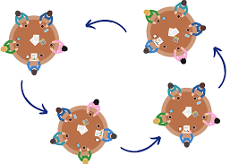
Engaging Strategy: World Café
Notes:
Purpose: Drawing on seven integrated design principles, the World Café methodology is a simple, effective, and flexible format for hosting large group dialogue.
How to facilitate this activity:
World Café can be modified to meet a wide variety of needs. Specifics of context, numbers, purpose, location, and other circumstances are factored into each event’s unique invitation, design, and question choice, but the following five components comprise the basic model:
1) Setting: Create a “special” environment, most often modeled after a café, i.e. small round tables covered with a checkered or white linen tablecloth, butcher block paper, colored pens, a vase of flowers, and optional “talking stick” item. There should be four chairs at each table (optimally) – and no more than five.
2) Welcome and Introduction: The host begins with a warm welcome and an introduction to the World Café process, setting the context, sharing the Cafe Etiquette, and putting participants at ease.
3) Small-Group Rounds: The process begins with the first of three or more twenty-minute rounds of conversation for small groups of four (five maximum) people seated around a table. At the end of the twenty minutes, each member of the group moves to a different new table. They may or may not choose to leave one person as the “table host” for the next round, who welcomes the next group and briefly fills them in on what happened in the previous round.
4) Questions: each round is prefaced with a question specially crafted for the specific context and desired purpose of the World Café. The same questions can be used for more than one round, or they may build upon each other to focus the conversation or guide its direction.
5) Harvest: After the small groups (and/or in between rounds, as needed), individuals are invited to share insights or other results from their conversations with the rest of the large group. These results are reflected visually in a variety of ways, most often using graphic recording in the front of the room.
There are many resources available for new World Cafe hosts, including a free hosting tool kit, World Cafe Signature Learning Programs, and subscription to the online Community Table, where the larger community of practice gathers to learn together.
Adapted from Harvard-U Discussion Protocols https://www.gse.harvard.edu/sites/default/files/Protocols_Handout.pdf
Adapted from http://www.theworldcafe.com/key-concepts-resources/world-cafe-method/

Slide 31
Brain Break: Chair Cat/Cow
Access video here
Notes:
Purpose: Chunk instruction and move, allow your brain's chemicals to reset
From https://pureedgeinc.org/brain-breaks-video-library-english/

Slide 32
Engaging Strategy: Give One, Get One
Notes:
Purpose: Share thoughts and key components from a text, video or data set using text-based evidence. Allow participants to build community by interacting with various peers and gathering information from one another.
How to facilitate this activity:
Students Prepare Ask students to divide a sheet of paper into two vertical columns. Label the left side “Give One” and the right side “Get One.”
Students Respond to a Question Ask students to respond to a question such as “Do you agree that laws are the most important factor in overcoming discrimination? Why or why not?” Students should write their ideas on the left-hand column on their paper. They do not need to write complete sentences; responses can be in list form.
Give One, Get One Tell students to walk around and find a partner. Each partner “gives,” or shares, items from his or her list. For example, Partner A shares his/her responses until Partner B hears something that is not already on his/her list. Partner B writes the new response in the right-hand column on the paper, along with Partner A’s name. Once Partner B has “gotten” one, the roles switch. Students repeat this process with other peers until time runs out.
4. Debrief
After this strategy, you will want to debrief in a class discussion and/or a journal writing session. Prompts for journal writing include:
How might you respond to the prompt or essential question now?
What did you learn today?
How does this information relate to the prompt or essential question?
What else do you want to know?
Teacher’s role As students share their ideas, teachers should keep notes. Pay particular attention to these details:
Patterns of insight, understanding, or strong historical reasoning
Patterns of confusion, historical inaccuracies, facile connections, or thinking that indicates students are making overly simplified comparisons between past and present
The goal is for students to share text-based evidence effectively and accurately. The following categories can guide you, the teacher, as you listen to your students’ discussion. Listen for these elements:
Factual and interpretive accuracy: offering evidence that is correct and interpretations that are plausible
Persuasiveness of evidence: including evidence that is relevant and strong in terms of helping to prove the claim
Sourcing of evidence: noting what the source is and its credibility and/or bias
Corroboration of evidence: recognizing how different documents work together to support a claim
Contextualization of evidence: placing the evidence into its appropriate historical context
As students debrief, weave in feedback. Affirm their insights. Highlight strong historical reasoning and text-based arguments. Choose one or two misconceptions about the content to address. Point out areas where students may want to reevaluate the ways they are connecting past and present.
Taken from https://www.facinghistory.org/resource-library/teaching-strategies/give-one-get-one

Slide 33
Brain Break: Sunrise/Sunset
Access video here
Notes:
Purpose: Chunk instruction and move, allow your brain's chemicals to reset
From https://pureedgeinc.org/brain-breaks-video-library-english/

Slide 34
Engaging Strategy: T-Chart, Pair, Defend
Notes:
Purpose: Engage in discussion about a debatable topic. Allow participants to engage in civil discourse and analyze various perspectives related to the debatable topic.
How to facilitate this activity: (sample video https://www.youtube.com/watch?v=OHukO5PNVoI)
Identify topics related to content that are able to be seen from two perspectives.
Prepare T Chart for students with a topic (Mining coal is necessary.) or a prompt (What is your opinion on mining coal?).
Present the content topic or prompt.
Students complete a T Chart showing both views, individually or as a group.
Students select one perspective to explain/defend and add notes to the T Chart.
Pair students with peers who have opposing views.
Students discuss and defend their perspective.
Students write a paragraph summarizing their viewpoint.

Slide 35
Brain Break: Chair Twist
Access video here
Notes:
Purpose: Chunk instruction and move, allow your brains chemicals to reset
From https://pureedgeinc.org/brain-breaks-video-library-english/

Slide 36
Reflective Closers
Finish lessons/meetings with a Reflective Closer to deliberately reinforce learning and highlight that our work has been important and will continue.
Slides 37-43 are examples of Reflective Closers. Directions are in the slide notes.

Slide 37
Reflective Closer: D.N.A. Strategy
Notes:
Edweek.org 4/6/2021
Purpose: The best way to build relationships with your students is to know their DNA:
DREAMS
NEEDS
ABILITIES
The more teachers tap into what motivates students and what each can bring to the classroom, the more they can target instruction. Do you know the whole person? Do you know their stories?
You can use this as an Engaging Strategy to reflect, take a deeper dive into practice and discuss in groups—what evidence do you have for each of these categories? OR use it as a Reflective Closer so participants can craft their next steps for building relationships with their students.

Slide 38
Reflective Closer
Something you loved learning or that aligned with your "why"
One point or idea that you will implement
Something that is rolling around in your mind
Something that squares
with your thinking
Notes:
Reflective closer. They are used in an intentional way to highlight that our work has been important and will continue. This kind of reflection helps participants to become independent learners and can also serve as excellent formative assessments, too.
We do hope you connect what we've done today to _________________________.
Let's take a look at these four statements. You're going to Choose and respond to ONE of the 4 statements in the chat & hit enter—you don’t have to wait this time:
1. Something you loved learning or aligned with your "why"
2. Something that squares with your thinking
3. One point or idea that you will implement
4. Something that is rolling around in your mind
Give a few seconds and then start reading a few out loud.

Slide 39
Reflective Closer: Whip-Around
Notes:
Purpose: Allow each student/staff to reflect on essential questions for the lesson and share something they learned.
How to facilitate:
1. The teacher will initially pose an open ended question to the class. There is no right or wrong answer.
2. Students are instructed to write down their thoughts on the same.
3. Following this, the teacher will whip around or walk around the classroom randomly calling out on students to voice out their thoughts.
4. Students are instructed to strike down similar answers and others are encouraged to share their unique thoughts with the rest of the class.
5. Once the answers are shared, teachers can have a quick review of the material and correct any mistakes or misunderstandings if any.
Here are some ideas to make the technique more interesting for students.
1) Up and down: Once the ideas or answers are noted down, the teacher will instruct the entire class to stand in their seats. They are then instructed to sit down if someone presents the same idea as written by them and to continue standing if their answer does not come up. As the teacher whips around the class, randomly picking students to read their notes, students will listen to each other and sit as and when their answers are named out. This method facilitates attentiveness of the class and allows the teachers to hear all the ideas.
2) Poll method: The teacher randomly calls out 3-5 students and quickly writes their answers on the board. The teacher then reads out the first answer listed down and asks the students with the same answer to raise their hands. The number of students is counted and written next to the answer. Students with ideas not in the list are then instructed to raise their hands, and the same are listed down. Writing down the thoughts facilitates retaining and recalling the information clearly.
3) Answer or pass: As the teacher whips around, students are encouraged to answer or say “pass” if they do not have an answer. Students with same answers are allowed to repeat the same and are encouraged to add something extra to the discussion. For students who previously said “pass”, a few minutes is given to come up with something new and to present to the class.
Adapted from Harvard-U Discussion Protocols https://www.gse.harvard.edu/sites/default/files/Protocols_Handout.pdf

Slide 40
Reflective Closer
List and share ONE strategy you will use this week
Notes:
Reflective closer. They are used in an intentional way to highlight that our work has been important and will continue. This kind of reflection helps participants to become independent learners and can also serve as excellent formative assessments, too.
1. List and share ONE strategy you will use this week.
2. Assign an accountability partner for this next week. Schedule 5 minutes (or longer) for a physical check-in or a virtual check-in. (Go beyond a text or email.) Talk about how those next steps are going.
Check-ins and check-outs help people remain connected

Slide 41
Reflective Closer: “I am” Monologues
Notes:
Purpose: Reflect on a lesson, connect person values, beliefs, identity and individual learners to key components of a lesson
How to facilitate this activity:
Students will assume the identity of a person, place, thing, or idea.
Then they will prepare a few short talking points from the point of view what they selected.
After creating a monologue, they will prepare to verbally share with peers by practicing their monologues.
Students will revise and modify their monologue before sharing in a small group.
After ample time for writing scripts and practice, students will perform their monologue.
Adapted from ELLEvation

Slide 42
Reflective Closer: I need, I don’t need
Notes:
Purpose: reflect on a meeting or lesson and identify areas of confidence and areas of support
How to facilitate:
Reflect on the lesson/meeting
Complete the following sentence stem on a post-it or piece of paper
I need…… (identify an area of support)
I don’t need (identify an area you are comfortable and confident with)
Share your statements with a partner

Slide 43
Reflective Closer: 1-1-1
1 confusing concept
1 paramount idea
1 takeaway
Notes:
Purpose: reflect on takeaways and identify key concepts that are important to your role in your school community and concepts that are confusing and you would like to revisit.
How to facilitate:
Think about what you learned through the lesson
Identify 1 key takeaway
Identify 1 concept that you need further support with
Identify 1 component that you can use “right now” to better your self or you thought was really important
Share your 1-1-1 with a partner
Debrief on how you can support each other with the confusing topic you identified

Slide 44
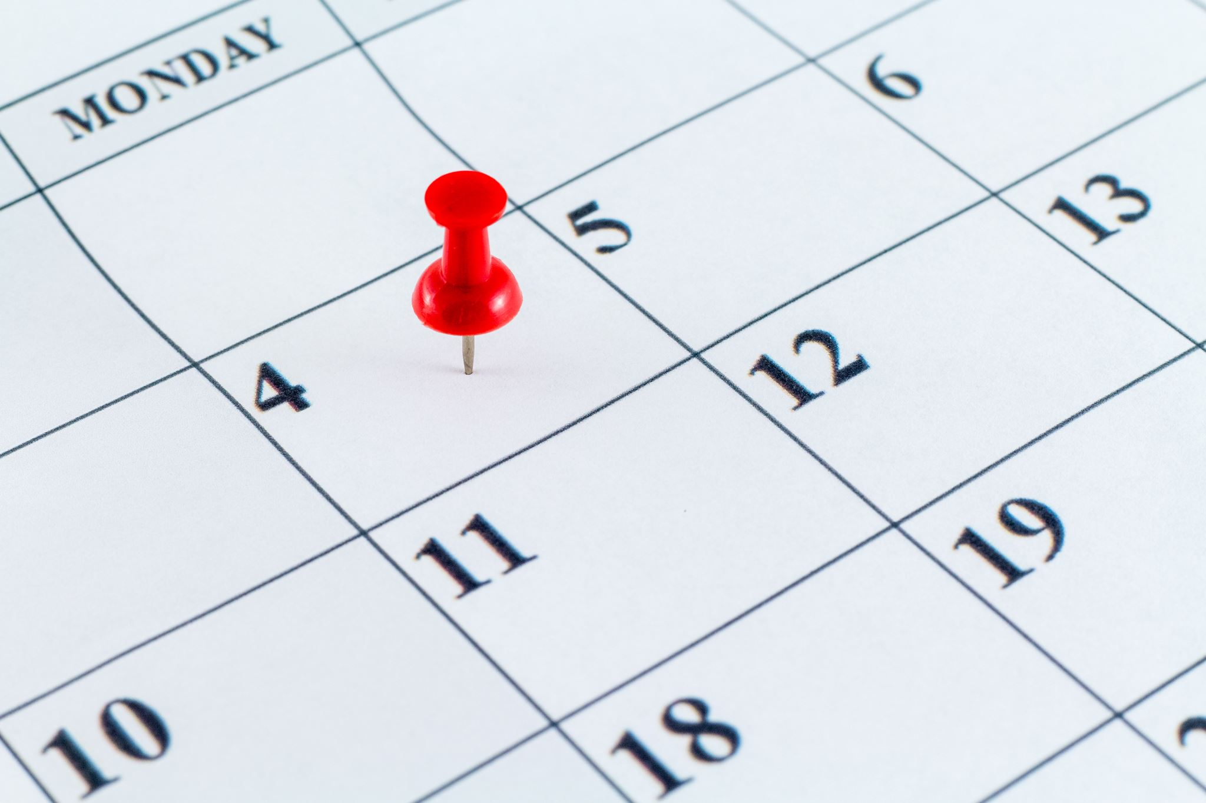
Daily Dedications
Slides 45-50 contain daily inspirational activities to make each day of the week more meaningful.
Notes:
Dedicate each day to some fun. Engage in some self-care or compassion work to boost your school community. The following slides offer some inspiration for each day of the week.

Slide 45
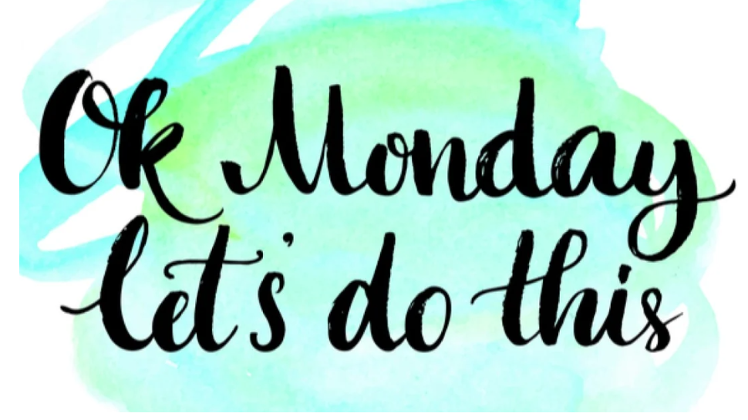
Notes:
Purpose:
1. Focus on reinforcing positive habits and self-compassion and strengthen resilience.
2. Create a positive culture and climate
Start the week off by setting an intention and writing an affirmation.
Use these sentence stems to generate your thoughts:
This week I will……
This week I am….
Samples of affirmations:
I'll get through ______.
I am valuable.
I belong.
I am enough.
I speak with confidence, clarity and authority.

Slide 46
Notes:
Purpose:
1. Focus on reinforcing positive habits and self-compassion and strengthen resilience.
2. Create a positive culture and climate
3. Take the time to reflect inwardly to notice feelings, thoughts, inner sensations—mindfulness. This grows the integrated fibers in your brain. When you peek inside yourself you have more coordination and balance in your nervous system, you focus your attention better, have emotional balance and a capacity to be more understanding of others. This integrates your brain and is an important part of your daily life. Dr. Dan Siegel, "Time-in" 3:24 – 4:16 https://www.youtube.com/watch?v=3EQ2tzHl3Ks
Terrific Tuesdays: Time-In
As an example: Reflect on your day. What is are some meaningful interactions that you encountered?
Write 3 things you are thankful for that made your Tuesday a terrific day.

Slide 47
Workout Wednesdays
Notes:
Purpose:
1. Focus on reinforcing positive habits and self-compassion and strengthen resilience.
2. Create a positive culture and climate
3. Build relationships when you do something in a group. Community is essential to your well-being
Encourage staff to engage in a movement-based brain break today!

Slide 48
Focus on the Bright Spots
Notes:
Purpose:
1. Focus on strengths, assets and bright spots.
2. Create a positive culture and climate, build relationships.
As an aside, one of the positive side-effects of focusing on bright spots: It improves behavior. Focusing on “bright spots” has been extensively researched in psychology, organizational change management and neuroscience. Those fields all agree that focusing on the positive not only feels good but also works when you’re trying to change or you want others to change.
Example:
Every Thursday this month is Thoughtful Thursday. Once a week each staff person randomly selects a name from a basket, jar, etc. Encourage staff to write a simple note of gratitude recognizing their colleague's positive behavior or something you saw them do (you'll need to surreptitiously do reconnaissance) and give it to them on Thursday at a specific time. Find the time to debrief how it's working!

Slide 49
Notes:
Purpose:
Create positive climate and culture
Express gratitude and reflect on some highlights from the week
Benefits of gratitude:
Increase in self-esteem
Increase in positive relationships
Build emotional endurance
Increase in social connection
Increase sense of empathy for others
Write 3 good things that happened this week. Explain why they are important to you.

Slide 50
Notes:
Purpose:
Increase practices of self-compassion
These 2 strategies provide insurance policies for your brain—they sooth the brain and the mind and build resilience. (The way you think, feel and act.)
Our body immediately begins to warn us when we are in a state of fear and/or anxiety. We NEED resilience so we don’t give up quickly when we’re faced with tasks, and so we don’t just bottle fear and anxiety up or freeze. Fear and anxiety, for example ACTIVATE at the cellular level through our genes. (Think about flipping our lids…) The amygdala starts to work with our UNCONSCIOUS mind. The signals amplify when we ignore them, and then you start to experience signals within your body.
Unleashing soothing activities when you’re in this state will help you get into a proactive state. You can switch other genes to help calm down the amygdala so you can think more clearly and get a balance of different brain waves; your nonconscious mind starts searching for good wisdom to respond. You need to get to the place that you can be PROACTIVE with your mind management by strengthening your neural networks. This helps you to function at a high level.
Emotions are warning signals, not diseases.
They are simple, yet important ideas:
1. Find something pleasurable to do today, (and everyday) even if it’s 3 minutes. 30 minutes to an hour is better. “This is good for me.” (Listen to Dr. Caroline Leaf’s podcast #342.) You are taking control of what your brain and your body look like. This can change your gene expression.
Examples: Listen to your favorite music and be fully present; really enjoy it—it has an incredible over-arching effect. Put it on and let it wash over you and enjoy it. You can do different things everyday. Perhaps it is reading fiction. Going on that walk with your family. Plan a dinner and/or a game night. Look for the jokes & find humor. You find something for you and commit to it. Make sure that your perception is this is valuable for your mental health b/c that will increase the dopamine and somatic transmission. This improves your memory! You are downregulating the genes that destroy neurons. This trains yourself to get into the wise mind.
2. Kindness is the next exercise. Practice being kind to yourself by looking at your inner critic! If you are thinking unkind things about yourself then you need to rewrite that script. Stop speaking to yourself in that irritated tone. Think of being kind to a child that’s learning something new and they make a mistake. This up-regulates those genes. If we feel good about ourselves not only will your mental health improve, but so will your relationships. Kindness stills the inner critic and quiets the brain noise. Kindness to yourself creates anti-chaos inside of your brain and body and cultivates wisdom. Bathe yourself in kindness.
Examples: Positive self-talk: reframe your mindset, show yourself some empathy and cut yourself some slack.

